Slide 1


Hope to Skills
Lecture# 23
Irfan Malik, Dr. Sheraz Naseer

Slide 2
Agenda
Neural Networks
Why Neural Networks
Hyper parameters
Learning rate
Epochs
Regularization
Activation functions
Play ground

Slide 3
Previous Lecture:
Lecture 22 - Introduction to Deep Learning
Click Here

Slide 4
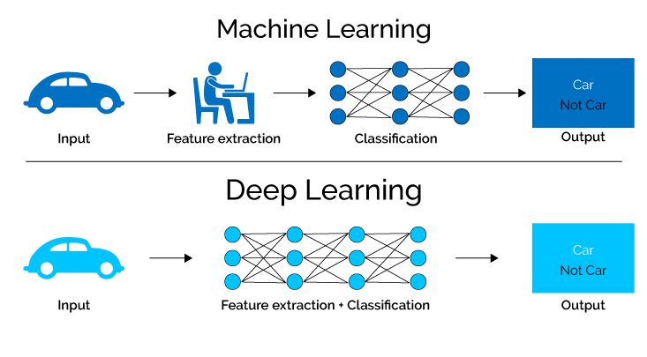
Recap

Slide 5
Shortcoming of Conventional ML
Can NOT directly work with unstructured, high dimensional data (Required Feature Engineering)
Example: Image and Video Data , Genes Data
Can learn only so much from available data (i.e performance does not increase after certain threshold even if more training data is available)

Slide 6
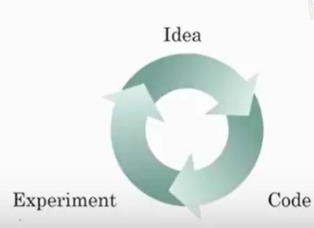
Why is Deep Learning Popular now ?
Most of the techniques used in deep learning are as old as 70 years, then why it is suddenly gaining so much traction ?
Data
Compute
Algorithm

Slide 7
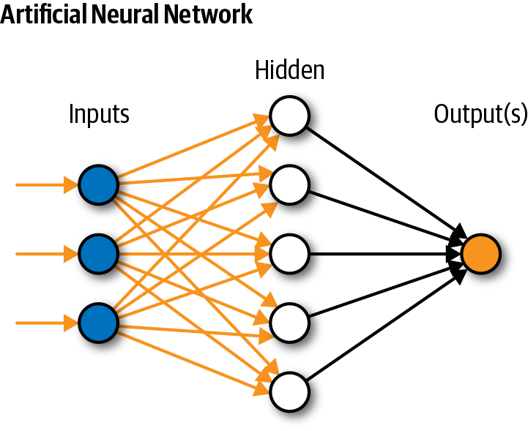
Simple Neural Network

Slide 8
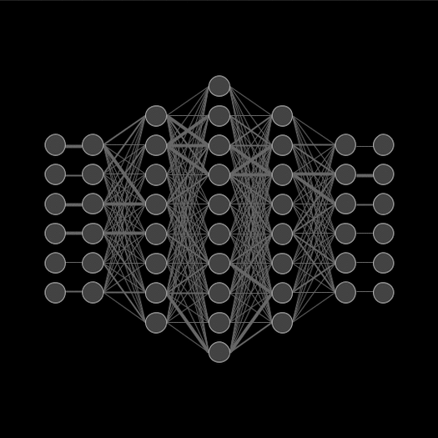
Neural Network

Slide 9

Types of Neural Network

Slide 10
Types of Neural Network

Slide 11
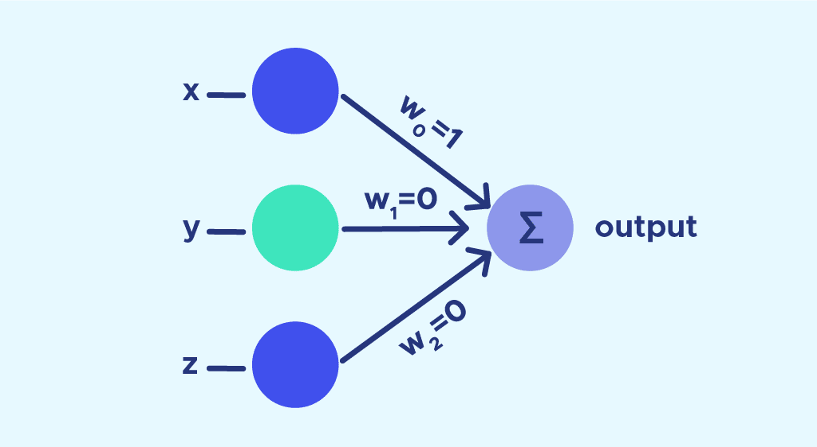
Perceptron
Perceptron is a supervised learning algorithm in machine learning that works by combining inputs with weights, passing them through an activation function, and making binary decisions based on the output.

Slide 12
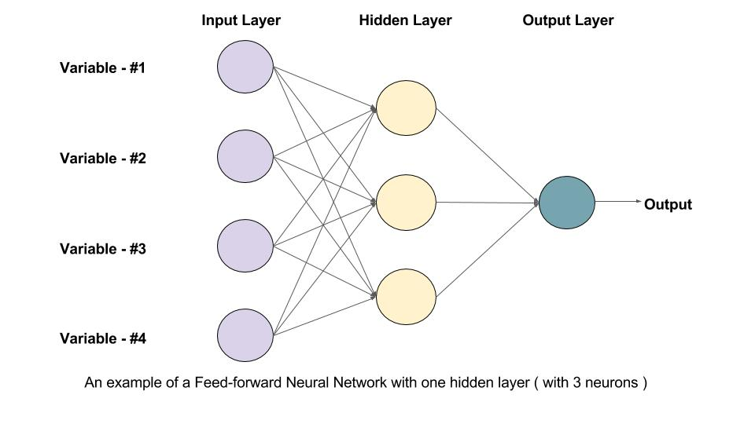
Feed Forward Neural Networks
FNNs play a crucial role in modern machine learning by processing input data through interconnected layers of neurons to produce meaningful outputs based on learned patterns. This network architecture is widely used in machine learning for tasks like image classification, natural language processing, and time series prediction.

Slide 13
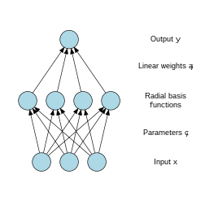
Radial Basis Function Neural Networks
RBFNNs are a specific type of Artificial Neural Network used for function approximation tasks. They differ from other NNs in their three-layer architecture, universal approximation capabilities, and faster learning speed.

Slide 14
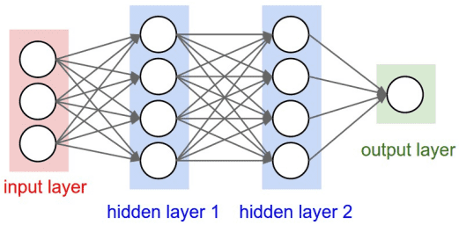
Deep Feed Forward Neural Network
These networks are particularly effective for tasks involving high-dimensional input data like images and text but can be challenging to train effectively. DFF process input data through multiple hidden layers to learn complex features and patterns in the data, making them powerful tools for tasks such as image classification, natural language processing, and prediction.

Slide 15
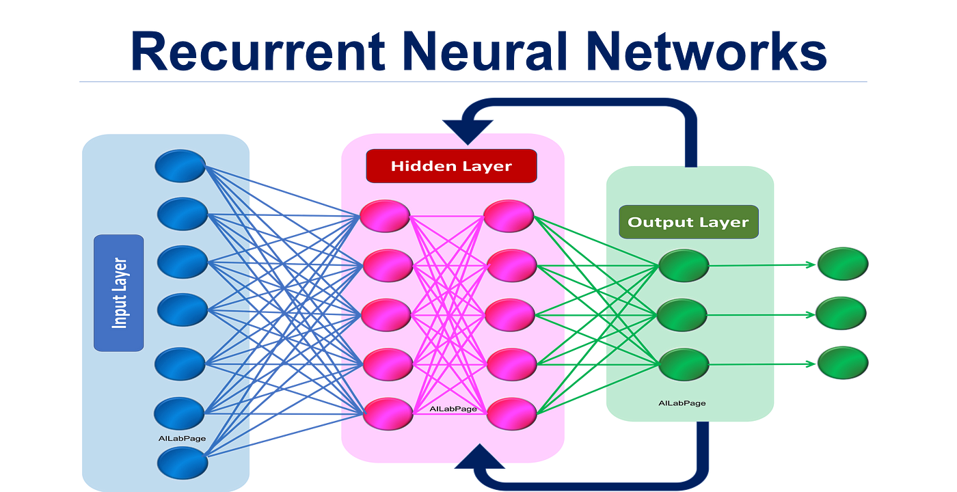
Recurrent Neural Networks
Recurrent Neural Networks (RNNs) are a type of artificial neural network designed for tasks involving sequential data like natural language processing, speech recognition, and time series prediction.

Slide 16
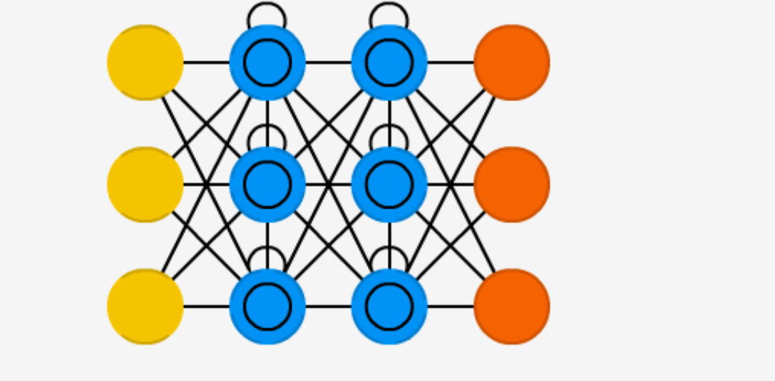
Long Short-Term Memory
LSTM networks are a type of RNN designed to address the vanishing gradient problem commonly encountered in traditional RNNs. LSTMs excel in capturing long-term dependencies in sequential data, making them ideal for tasks like language translation, speech recognition, and time series forecasting.

Slide 17
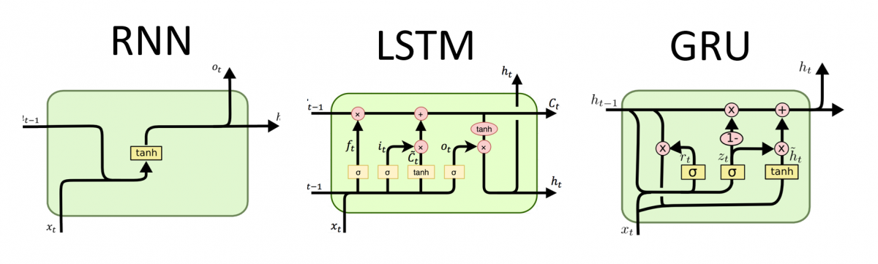
Gated Recurrent Unit
GRU is a type of RNN that addresses challenges in processing sequential data. GRUs are designed to overcome the vanishing gradient problem encountered in traditional RNNs by incorporating gating mechanisms. They find applications in various domains like natural language processing, speech recognition, and time series prediction.

Slide 18
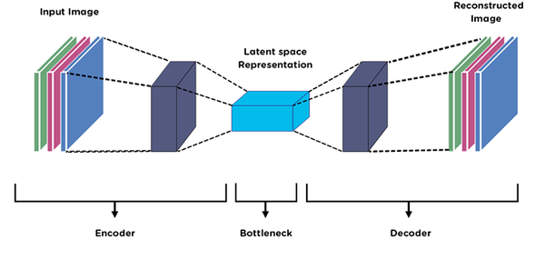
Autoencoder
Autoencoders are a specialized class of algorithms within ANNs designed for unsupervised learning. They work by learning efficient representations of input data without specific labels. The core principle of an autoencoder involves a two-fold structure consisting of an encoder and a decoder.

Slide 19
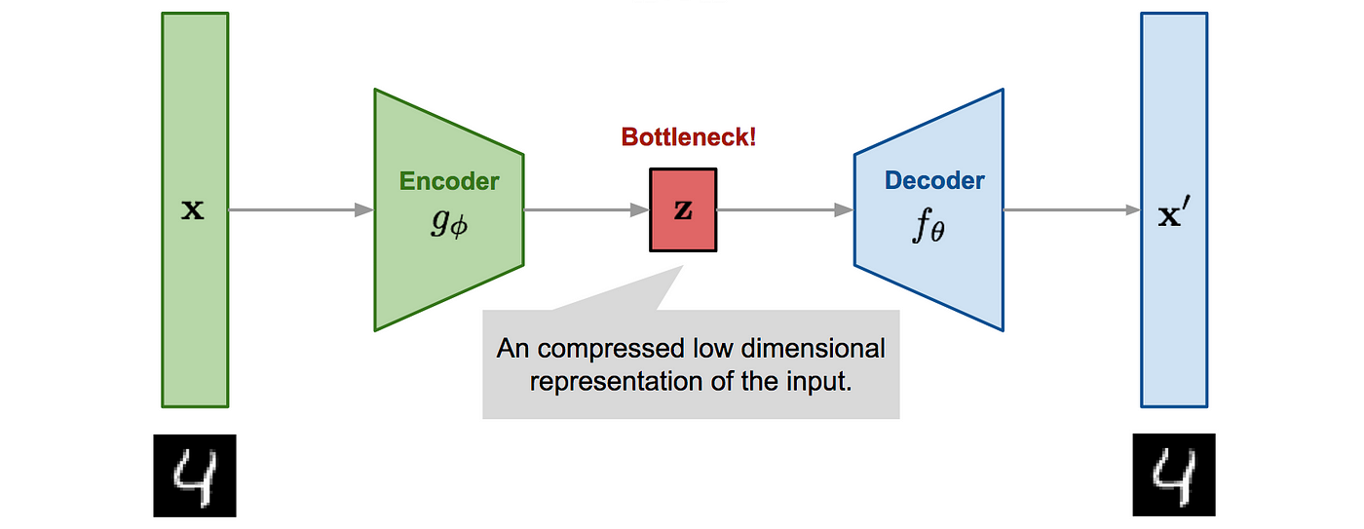
Variational Autoencoder
A VAE is an ANN architecture that combines an encoder, a decoder, and a loss function. It introduces a regularizer, the Kullback-Leibler divergence, to ensure the latent space is well-structured. VAEs aim to learn efficient representations of data by encoding input into a latent space and decoding it back, enabling tasks like data generation and compression.

Slide 20
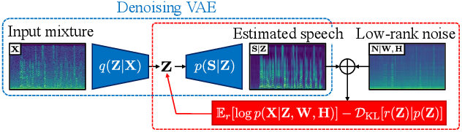
Denoising AE
A DAE is a type of NN that is trained to remove noise from input data. It works by reconstructing clean data from corrupted or noisy input, helping to enhance the quality of the data and improve generalization capabilities in tasks like image denoising and signal processing.

Slide 21
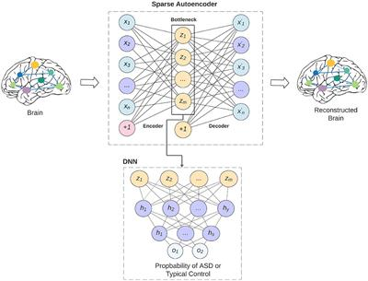
Sparse AE
A Sparse Autoencoder (SAE) is a variant of autoencoders that enforces sparsity in the learned representations, aiming to have only a few active neurons at a time. This approach helps in creating an information bottleneck and improving performance on tasks like dimensionality reduction and feature learning.

Slide 22
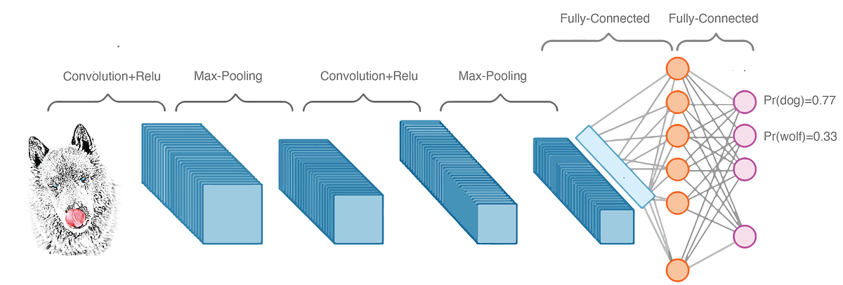
Deep Convolution Network
A deep neural network architecture that utilizes deconvolution layers, often used for tasks like image deconvolution, featuring a hierarchical decomposition of input data to extract features at different levels.

Slide 23
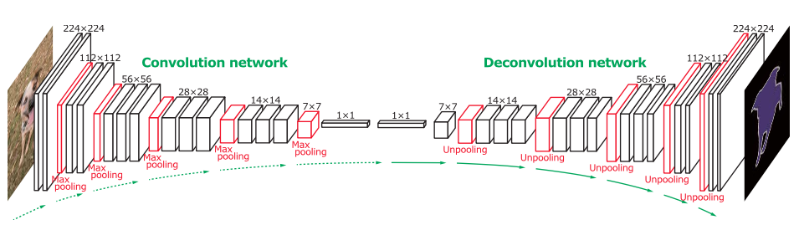
Deconvolution Network
Deconvolution Network (DN): A network that employs reversed convolutional layers to reconstruct lost features or signals, commonly used in image synthesis and analysis tasks.

Slide 24
Deep Convolution Inverse Graphics Network
The DC-IGN is a NN model that learns interpretable representations of images by disentangling transformations like rotations and lighting variations. It utilizes convolution and deconvolution operators and is trained with the Stochastic Gradient Variational Bayes algorithm to generate new images with variations in pose and lighting based on learned latent variables.

Slide 25

Types of Neural Network

Slide 26
Hyper-parameters
A hyper-parameter in machine learning is a parameter set before training that controls the learning process and influences the model's learned parameters. These external configuration variables, like learning rate or batch size, are crucial for optimizing model performance and are distinct from internal model parameters.

Slide 27
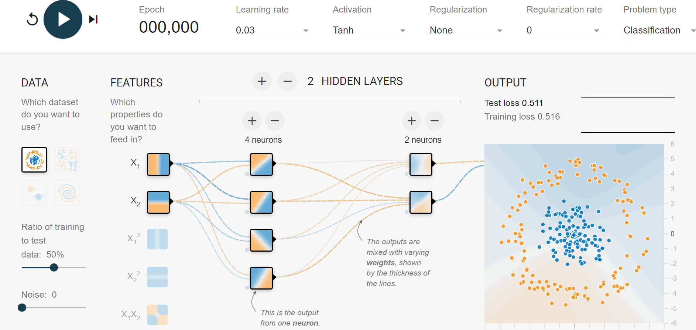
Hyper-parameters

Slide 28
Learning Rate
A hyperparameter that controls the step size during gradient descent optimization. It determines how quickly the model adjusts its parameters in the direction that reduces the loss.
A higher learning rate might lead to faster convergence but risks overshooting, while a lower rate might slow down convergence.

Slide 29
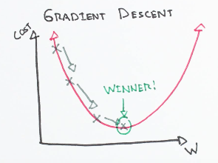
Gradient Descent

Slide 30
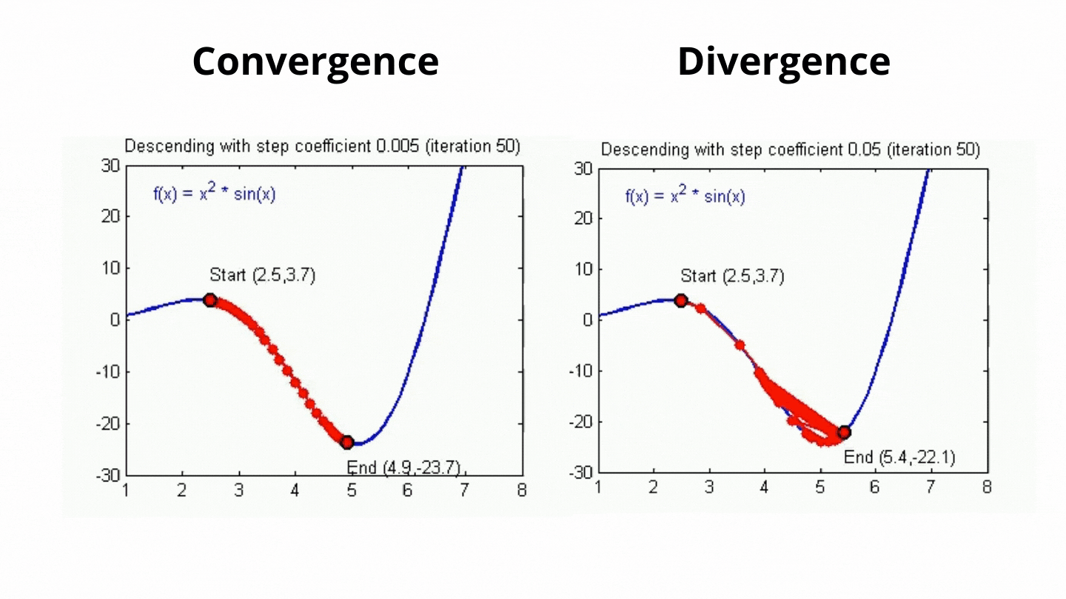

Slide 31

Learning Rate
A higher learning rate might lead to faster convergence but risks overshooting, while a lower rate might slow down convergence.

Slide 32
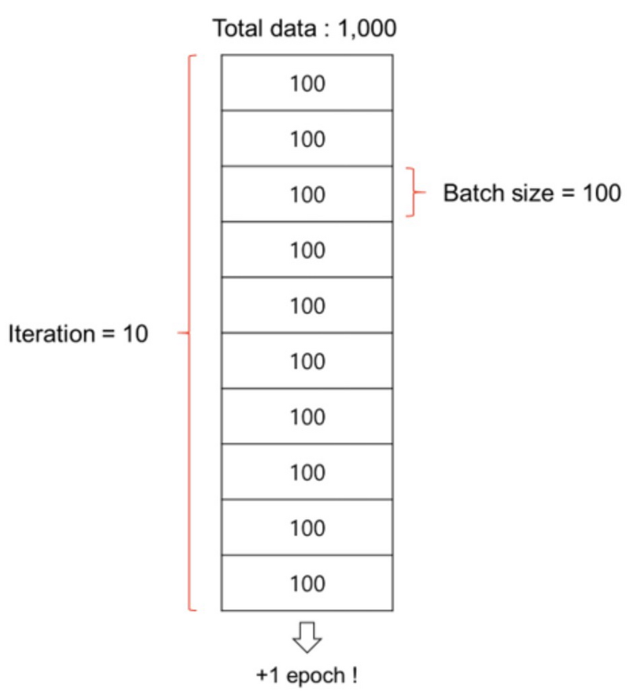
Batch Size
Batch is a subset of the training dataset used in each iteration of the training process.
Instead of processing the entire dataset
at once, we divide it into smaller batches.

Slide 33
Batch Size
Batch size is the number of training examples in each batch.
It's a hyperparameter that can be adjusted based on hardware limitations and dataset characteristics.
Larger batch sizes may speed up training but require more memory.

Slide 34
Number of Epochs
The number of times the entire training dataset is seen by the model during training.
Too few epochs might result in underfitting, while too many epochs can lead to overfitting.

Slide 35
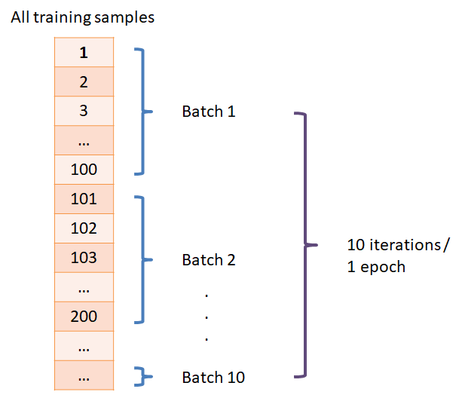
Number of Epochs

Slide 36
Activation Functions (Neuron)
It determine the functions applied to the outputs of each neuron to introduce non-linearity.
Common activation functions include
ReLU (Rectified Linear Unit),
Softmax

Slide 37
Let Move to Playground

Slide 38
Quiz:
Lecture 23 : Quiz 8 https://forms.gle/GiRC8hAhWWqbyNQu5
Click Here

